Slide 1
ANNUAL
REPORT 2023
WISCONSIN MARITIME MUSEUM

Slide 2
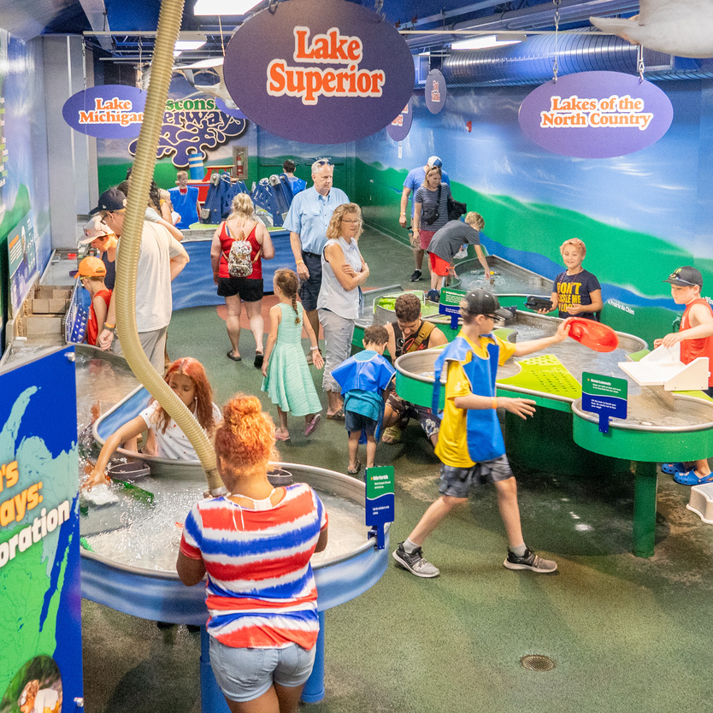
MISSION STATEMENT
The Wisconsin Maritime Museum connects all people with Wisconsin’s waterways, by engaging and educating the public about the Great Lakes, Wisconsin’s maritime history, Wisconsin’s World War II submarines and USS Cobia.
01
ANNUAL REPORT 2023

Slide 3
STAFF
Catherine Green
Executive Director
Kevin Cullen
Deputy Director & Chief Curator
Caroline Diemer
Programming Coordinator
Ariel Ducat
Overnights & Groups Coordinator
Karen Duvalle
Sub Curator & Events Coordinator
Elizabeth Farrey-Luerssen
Community Engagement Coordinator
Amy Fettes
Business Manager
Greg Lutz
Visitor Engagement & Store Manager
Paul Rutherford
Maintenance Supervisor
Alyssa Saldivar
Operations Manager & Volunteer Coordinator
Emily Shedal
Development Coordinator
02
ANNUAL REPORT 2023

Slide 4
BOARD OF TRUSTEES
Jeff Sabel
President
Rich Larsen
Treasurer
Thomas Griesbach
Secretary
Scott Ferguson
Sam Grage
Daniel Hassemer
Darian Kaderabeck
ex ofﬁcio, City of Manitowoc
Logan Rooney
Dan Schneider
Tom Wright
Jamie Zastrow
Howard Zimmerman
03
ANNUAL REPORT 2023

Slide 5
BY THE NUMBERS
ATTENDANCE
33,299
EDUCATION
3,696 People Participated in Field Trips
EVENT RENTALS
$37,757
SUB PUB REVENUE
$48,286

Slide 6
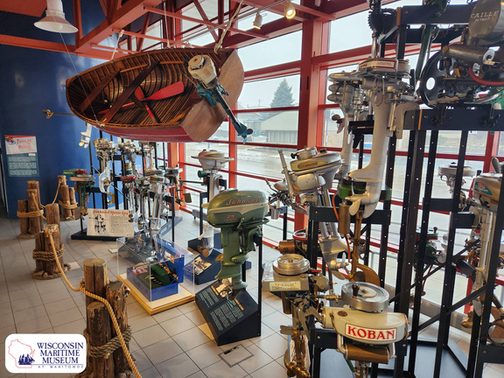
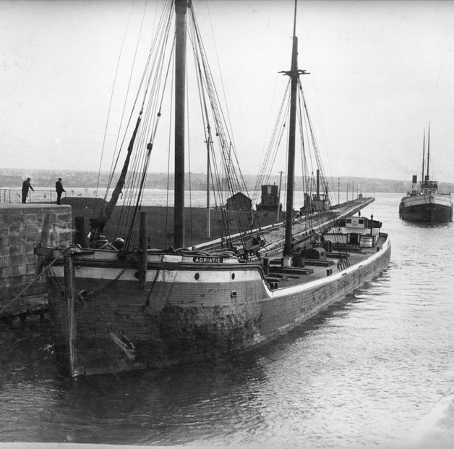
EXHIBITS
Bringing Shipwrecks to Life
Towers of Power – A Century of Outboard Motors
Bringing Shipwrecks to Life featured state-of-the-art underwater photography by internationally renowned photographer, Becky Kagan Schott of Liquid Productions. This dynamic exhibit included interactive 3D digital models of featured shipwrecks, along with 3D models and authentic shipwreck artifacts from the museum’s collection.
This exhibit features dozens of early to mid-20 th century outboard boat motors all made by midwestern companies. These innovative machines feature exceptional design and engineering. Towers of Power is displayed on tall tower structures in the museum’s main concourse.
ADRIATIC and the Birth of Self-Unloading Ships
The Tiny Art Show
The Lakeshore Artists Guild in partnership with the Wisconsin Maritime Museum presented the Tiny Art Show for the first time at the museum. The temporary exhibit featured over 150 pieces of art by 38 regional artists.
Located on the museum’s lower level, this permanent installation features some of the oldest self-unloading equipment on the Great Lakes that was salvaged from the shipwreck Adriatic in Sturgeon Bay. This exhibit also includes a hands-on bucket conveyor interactive that demonstrates how the Self-Unloading technology worked.
05
ANNUAL REPORT 2023

Slide 7
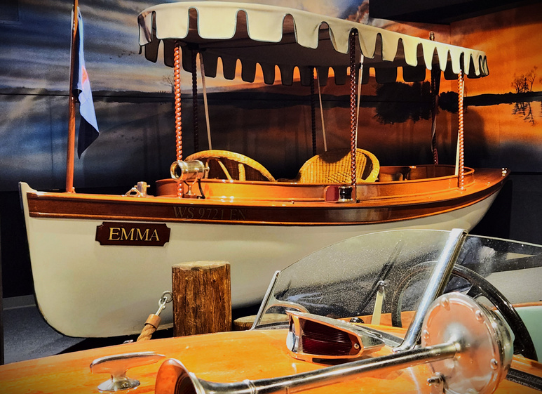
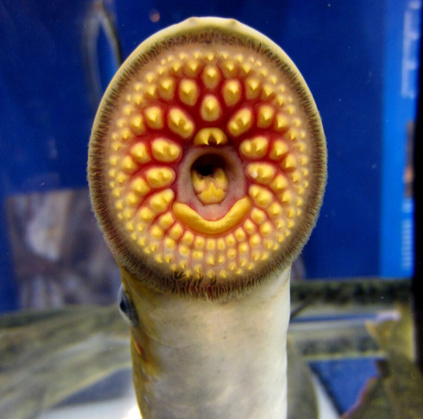
EXHIBITS
Electric Launches of the 1890s
Modeling the Age of Sail
The Wisconsin-Built Boat Gallery showcases a recent donation to the museum’s permanent collection. Emma is a 20-foot-long wooden launch, built in 1899 by the Pierce Engine Company of Racine, WI. The boat spent much of its early life on the lakes around Milwaukee, before being restored by Bruce Renquist in the 1990s.
Upgrades to the Model Boat Gallery featured a recently completed model of Milwaukee’s fabled sailing vessel Moonlight, built by Ted McCutcheon. Discover how this renowned ship modeler combined historical research and mathematical precision to produce this beautiful fully rigged schooner model.
Attack of the Sea Lampreys!
Experience these curious and deadly creatures up close with a tank filled with live sea lampreys collected from the Peshtigo River. Learn about how aquatic biologists are battling these predators, while safeguarding a world-class fishery. This interactive exhibit is located in the Invasive Species Lab in the museum's lower level.
06
ANNUAL REPORT 2023

Slide 8
EDUCATION & OUTREACH
Field Trip Participants
Program Attendance
3,696
2,702 IN PERSON
Outreach Events
659 ONLINE
REACHED 5,500 AT 17 EVENTS
07
ANNUAL REPORT 2023

Slide 9
OVERNIGHTS
Total Participants
3,231
Overnight Revenue
$ 157,278
Overnight Groups
146
08
ANNUAL REPORT 2023

Slide 10
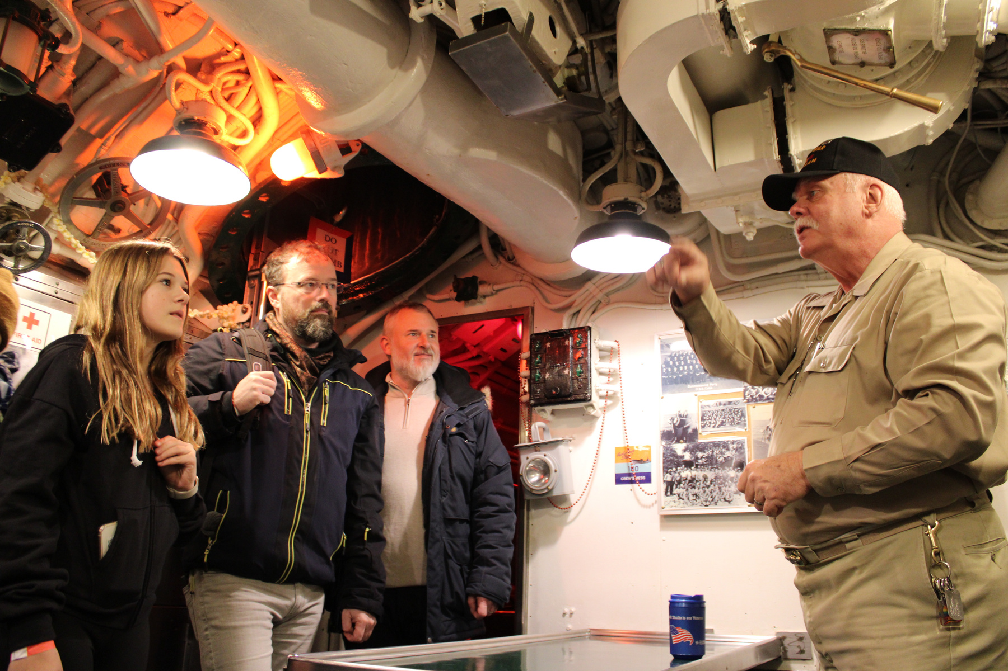
VOLUNTEERS
Total volunteers in 2023: 71
Total hours: 2613.49
New volunteers: 10 (Including 5 highschoolers who came for their 20-hour community service and decided to continue)
Volunteer with the most hours: Greg Miller @ 286 hours
09
ANNUAL REPORT 2023

Slide 11
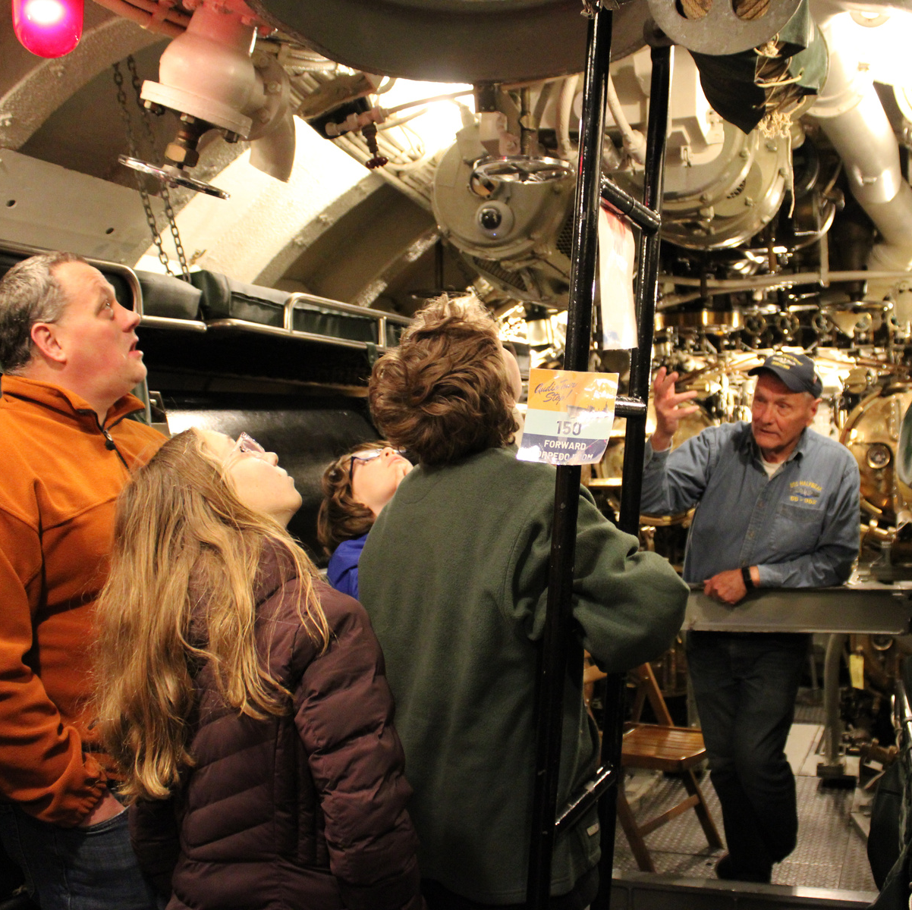
VOLUNTEERS
Largest projects
USS Cobia deck parties
replacing decking with new planks to ensure safety
USS Cobia crews’ quarters head
restored and open to the public
Collections
Updating locations of all artifacts and re-cataloguing
New things coming in 2024
Volunteer Newsletter
even months- please reach out if you would like to be added to the mailing list
Volunteer appreciation event in Summer
USS Cobia Dry Dock Projects
10
ANNUAL REPORT 2023

Slide 12
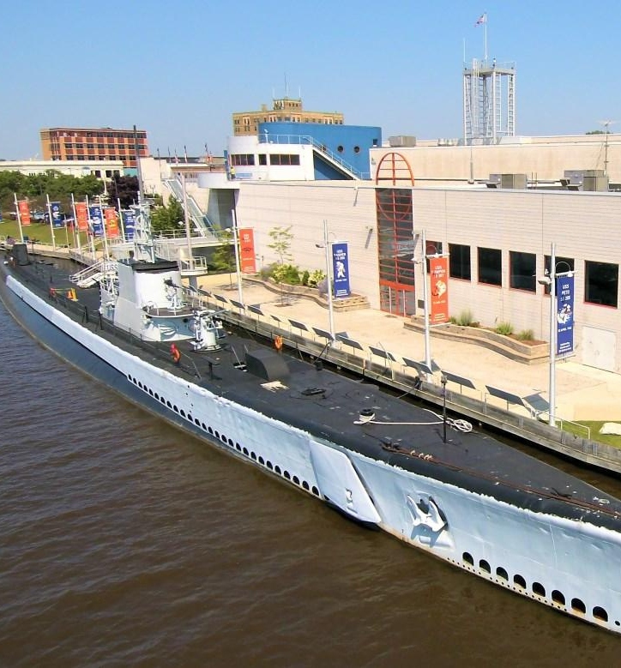
USS COBIA DRY DOCK
CURRENT DRY DOCK ENDOWMENT
$247,838
28 BOAT CAMPAIGN
$31,000
GIVING TUESDAY
$5,840
SAT GRANT
$500,000
11
ANNUAL REPORT 2023

Slide 13
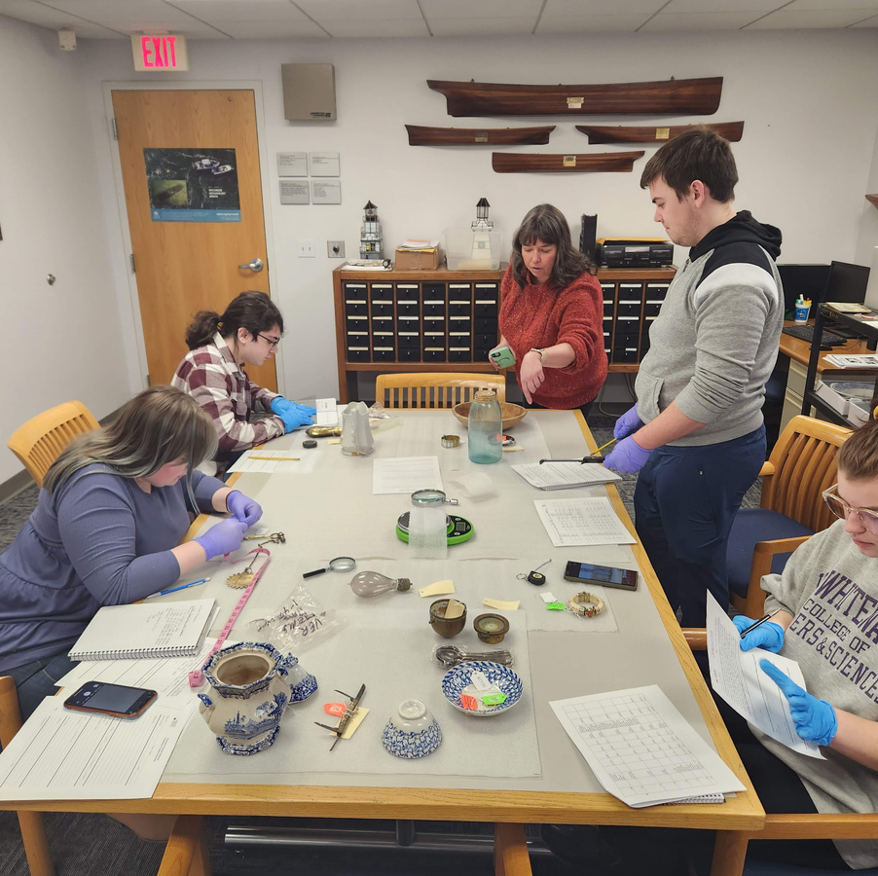
COLLECTIONS
Former Collections Manager, Hannah Patten, started new position at Wisconsin State Historical Society in February 2024.
New Collections Manager, Serena Stuettgen, starting on April 29th.
12
ANNUAL REPORT 2023

Slide 14
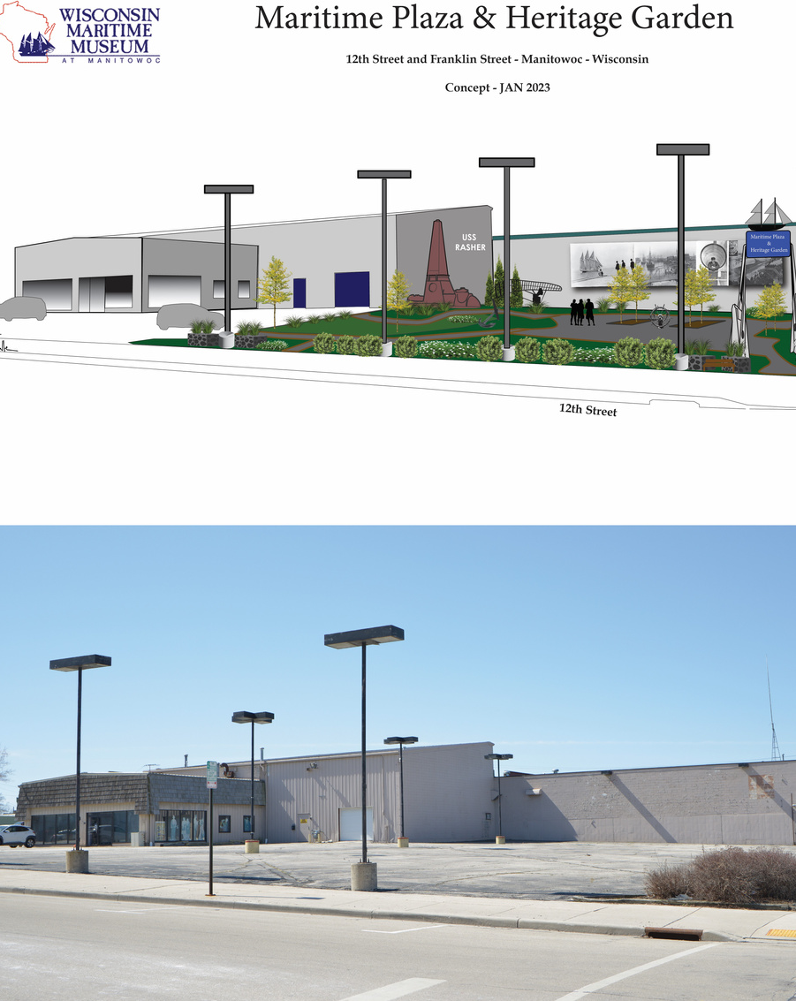
WISCONSIN MARITIME HERITAGE CENTER
Phase 1 began fall 2023 with the complete rehab and repair of North Bay, the original 1920s portion of the structure. It will be completed this spring, and includes a mural highlighting the museum's historic photograph collection.
We have raised over $400,000 toward the first 2 phases of the project, both exterior facing elements. The Maritime Heritage Plaza and Gardens is phase 2 and will begin this summer.
13
ANNUAL REPORT 2023

Slide 15
DEVELOPMENT
TOTAL MEMBERS: 393
ANNUAL APPEAL $49,649
GRANTS
$154,000
14
ANNUAL REPORT 2023

Slide 16
DEEPENING PARTNERSHIPS
$250-
$499
Americollect Inc.
Cellcom
Lakeshore Artists Guild
Late's BBQ
Midwest Model Shipwrtights
Network for Good
PEO
Sunrise Optimist Club of Manitowoc
The Cawley Company
The Kraft Group
The Nautical Research Guild
Todd Glover - State Farm Insurance
Rocky Mountain Shipwrights
US Submarine Veterans Base - Wisconsin
Wisconsin Scale Boating Association
Wrap It Up
$500-
$999
Ansay & Associates LLC
Carron Net Company, Inc.
Cellcom
Doneff Companies LLC
Ignite
Kaysun Corporation
McMullen & Pitz Construction Company
Michaels Construction
Shoreline Credit Union
The Cawley Company
The Leede Research Company
Twin Rivers Improvement
VT Industries
Walmart
15
ANNUAL REPORT 2023

Slide 17
DEEPENING PARTNERSHIPS
$501-$1,999
$2,000-$5,000
Allstates Rigging
Bank First
Burger Boat Company
City Centre LLC
Fox Communities Credit Union
Hamann Construction Company
Jacques Weber Foundation
Lakeside Foods
Manitowoc Sunrise Rotary
Michael Best & Friedrich LLP
NextEra Energy Resources - Point Beach Nuclear Plant
Philip Ross Industries
Schaus/Maritime Plumbing
Steimle Birschbach LLC
UnitedOne Credit Union
Vagabond Studios
Washington Island Ferry Line, Inc.
A.C.E. Building Service, Inc.
Festival Foods
Kahlenberg Industries
Manitowoc Marina
Manitowoc Public Utilities
Meijer
Nicolet National Bank
Philip Ross Industries
Wisconsin Aluminum Foundry
$10,000+
City of Manitowoc
Community First Credit Union
Pete G. Horton Charitable Trust
West Foundation
16
ANNUAL REPORT 2023

Slide 18
REVENUE AND
CUSTOMER REVENUE
17
ANNUAL REPORT 2023

Slide 19
EXPENSES
18
ANNUAL REPORT 2023

Slide 20
2024 PREVIEW
Upcoming Events:
Shipwrecks Day - April 20th from 10 AM - 3 PM
Think & Drink - First Thursday of Each Month at 6:30 PM
Manitowoc County Member Swap Weekend - May 16-19th
SubFest 2024 - July 4th-7th
Plein Air Paint Out - August 3rd
Smoke on the Water - August 7th
Christmas Tree Ship Day - December 7th
19
ANNUAL REPORT 2023

Slide 21
THANK YOU!
Wisconsinmaritime.org
75 Maritime Dr.
Manitowoc, WI 54220
920-684-0218

